Slide 1


Integration Tests using Docker, Scala, Akka & ScalaTest
Andreas Gies
Lead Architect
Notes:
Yoga Bilder, Yoga & IT Kurse, Customized Seminare

Slide 2


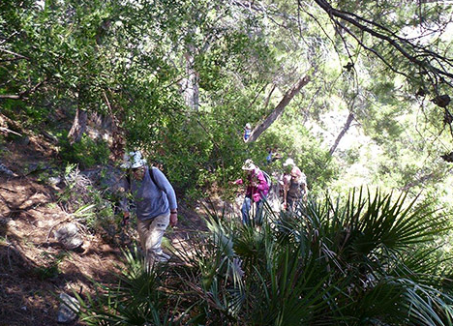
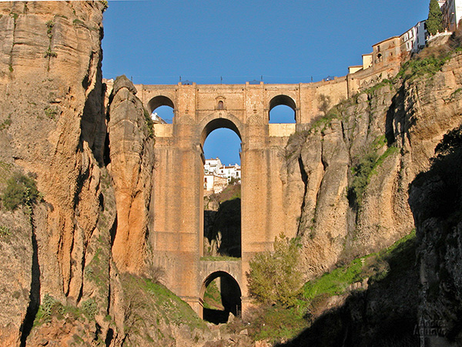
Technical Consulting
Conference speaking slots
Technical Trainings
Management Seminars
Team Breakouts
Coding by the sea
Yoga & learning
Team Building
Enjoy Andalucia
Notes:
Wander bild einfuegen

Slide 3

Example Test

Slide 4
A sample container under test
Notes:
Link Picture to actual source code on github

Slide 5
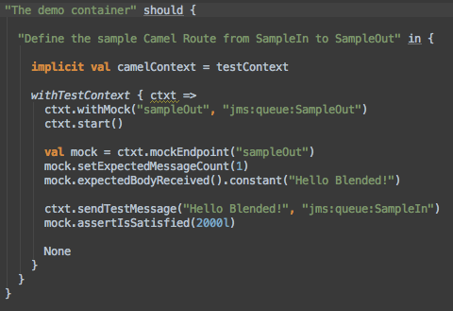
An example test
Notes:
Link Picture to actual source code on github

Slide 6
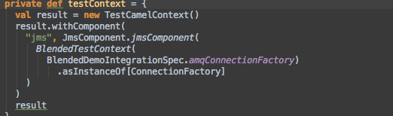
The example test context
Provide a Camel based test context with all required components for testing

Slide 7
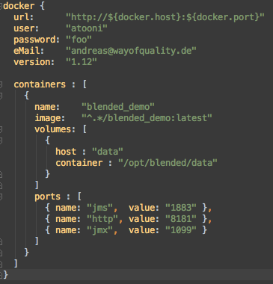
The container under test
Docker Connector
Container Reference
Exported Volumes
Exported ports

Slide 8
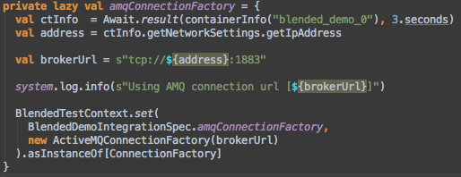
Providing the JMS connection
We know the JMS port is 1883 and Active MQ is the JMS provider
Keep information relevant across Specs in an instance of BlendedTestContext

Slide 9
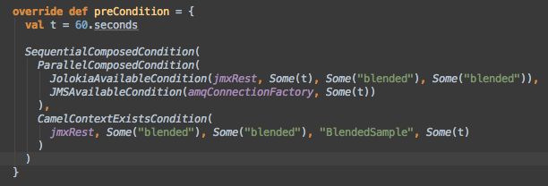
Waiting for the container
Wait until Jolokia, JMS and the Camel Route under test are available

Slide 10

Writing Tests

Slide 11
Test packaging
Notes:
Sequenz kreieren

Slide 12
High Level Test Architecture
Notes:
Sequenz kreieren

Slide 13
An Akka based Container Mgr
Notes:
Sequenz kreieren

Slide 14
Container Actor
Notes:
Sequenz kreieren

Slide 15
Managing Conditions
Notes:
Sequenz kreieren

Slide 16
Composed Conditions
P
S
Notes:
Sequenz kreieren

Slide 17
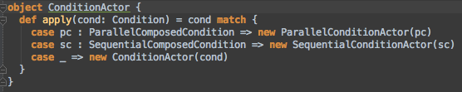
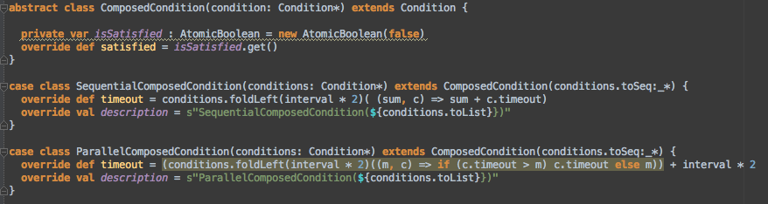
Composing Conditions
Notes:
Sequenz kreieren

Slide 18

Creating docker images

Slide 19

Docker in a nutshell

Slide 20
Layering Docker images

Slide 21
Basic Container Test image
# The basic image to run Blended containers
FROM centos:6.4
MAINTAINER Andreas Gies version: 1.0.7-M6-SNAPSHOT
# Installation section
RUN groupadd blended
RUN useradd -d /home/blended -s /bin/bash -g blended -m blended
ADD files/jdk-7u60-linux-x64.tar.gz /opt
RUN ln -s /opt/jdk1.7.0_60 /opt/java
# End of Installation section

Slide 22
Deriving the image under test

Slide 23
Container configuration
FROM atooni/blended-base:latest
ADD blended-karaf-demo-${project.version}-nojre.tar.gz /opt
RUN ln -s /opt/blended-karaf-demo-${project.version} /opt/blended
RUN mkdir -p /opt/blended/data
RUN chown -R blended.blended /opt/blended*
USER blended
ENV JAVA_HOME /opt/java
ENV PATH ${PATH}:${JAVA_HOME}/bin
ENTRYPOINT ["/opt/blended/bin/karaf"]
VOLUME /opt/blended/data
EXPOSE 1883
EXPOSE 8181
EXPOSE 1099

Slide 24
Pom File definitions
Dependency on distributable archive
Reference Docker definition file
Use dependency plugin to retrieve archive
Invoke docker plugin

Slide 25
Docker tricks
Configuring docker for integration tests
Creating the TCP-IP Connector
Cleaning up docker

Slide 26

Writing Tests

Slide 27
General tasks to write tests
Define the containers under test
Waiting for Containers to be started
Connecting to the Containers
Test fixtures
Boilerplate test context

Slide 28
A slightly bigger use case
{
name: "gs4"
image: "^kaufland_sibfile:latest"
links: [ "shop_0:shop" ]
ports: [
{ name: "http", value: "8181" }
]
volumes: [
{
host: "data"
container: "/opt/sibfile/data"
},
{
host: "tmp"
container: "/tmp"
}
]
}
{
name: "shop"
image: "^kaufland_shop:latest"
links: [ "sonic_0:sonic" ]
volumes: [
{
host : "data"
container : "/opt/shop/data"
}
]
ports : [
{ name: "ftp", value: "4747" },
{ name: "http", value: "8777" },
{ name: "jms", value: "1883" }
]
},
{
name: "sonic"
image: "^kaufland_sonic:latest"
ports : [
{ name: "data", value: "2620" },
{ name: "mgmt", value: "2608" }
]
},

Slide 29
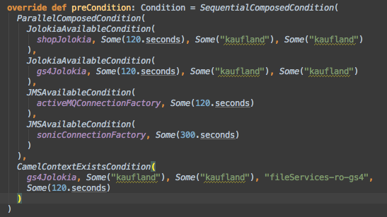
Wait until the CuT are ready

Slide 30
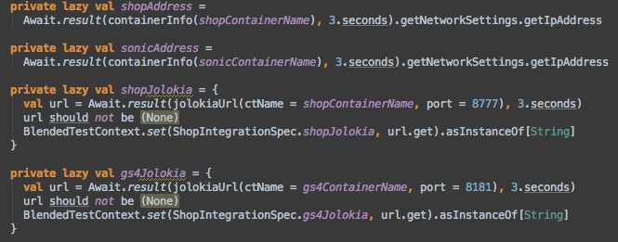
Connect to the CuT’s

Slide 31
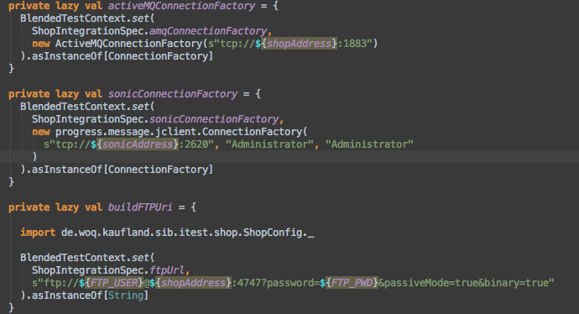
Connect to the CuT’s

Slide 32
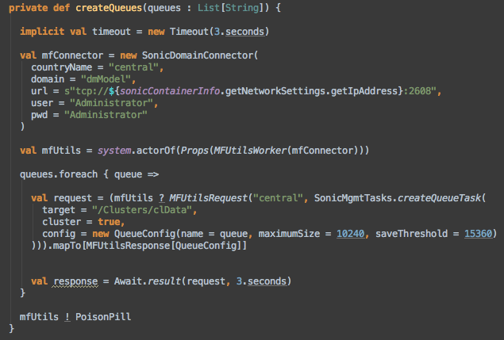
Text fixtures

Slide 33
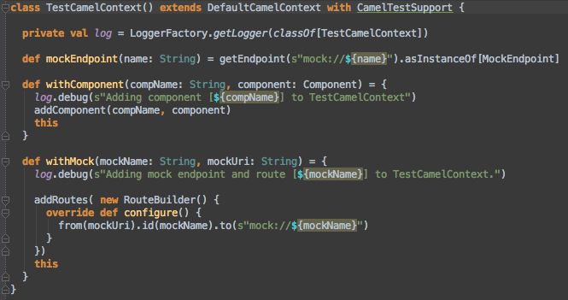
A Boilerplate Test Context

Slide 34
CamelTestSupport
Create & send test messages
Wire mock Endpoints
Frequently used message assertions

Slide 35
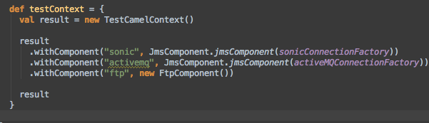
Injecting components

Slide 36
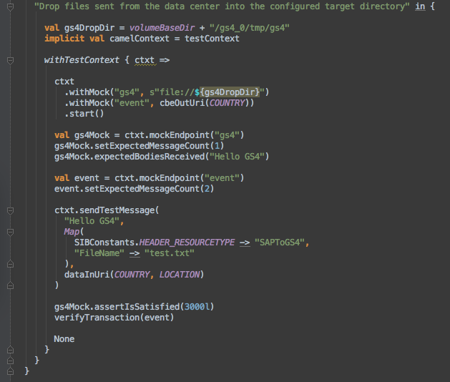
Finally – The spec

Slide 37
More test support
Akka based JMS producer/consumer for throughput measurements (Early stage)
Akka based Jolokia client to Query the container’s JMX resources via REST

Slide 38
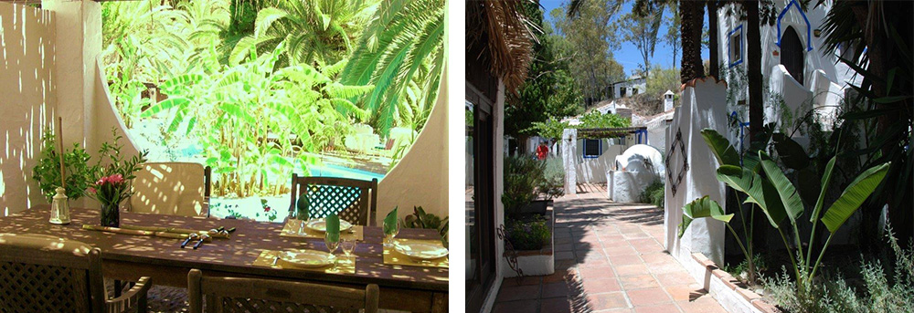
Integration test guidelines

Slide 39
Integration Test Guidelines
Concentrate on Blackbox Tests
Aka Don’t modify the CuT to test it …
Identify the Communication endpoints
Aim for readable Specs and discuss with end users
Specify Green and Red Path Tests
Try to capture load scenarios
Hard to define due to machine dependencies
Test fixtures
Try to abstract test fixtures into abstract classes

Slide 40

Integration test guidelines

Slide 41
Conclusion

Slide 42
More to come…
Working
Wishlist / Issues
Container Management
Test Framework with easy hooks to CuT
Implicit Test Context for Blackbox testing
Syntactic sugar and support for Camel based black-box testing
More syntactic sugar for Conditions
Networking issue on OS X
Kill Containers throughout test for failover testing
Leverage a hosting env. like Openshift to execute Containers under test
Publish Test Framework as self-sufficient project

Slide 43
Resources
GitHub Project Blended
Travis Build – Waffle Board – Codacy Code metrics - Project Page
Way of Quality Homepage
Scala – Akka – Docker – ScalaTest
Apache Camel - for writing test routes
Apache Karaf - The containers under test in the samples
Apache ActiveMQ - The JMS layer used in the samples
Hawtio – The management console of the test containers
Jolokia – A JMX to REST bridge

Slide 44

Stay in contact !
andreas@wayofquality.de
http://de.linkedin.com/pub/andreas-gies/0/594/aa5
https://www.facebook.com/andreas.gies.5
@andreasgies, #WOQ-Blended on Twitter
Enjoy a course or a coding breakout

